Slide 1

hiring process analysis
Prepared by: Aniruthya A

Slide 2
Here's what you'll be doing:
Handling Missing Data: Check if there are any missing values in the dataset. If there are, decide on the best strategy to handle them.
Clubbing Columns: If there are columns with multiple categories that can be combined, do so to simplify your analysis.
Outlier Detection: Check for outliers in the dataset that may skew your analysis.
Removing Outliers: This could be removing them, replacing them, or leaving them as is, depending on the situation.
Data Summary: This could involve calculating averages, medians, or other statistical measures. It could also involve creating visualizations to better understand the data.
Description

Slide 3
Tool Used : Microsoft excel
Features Used:
-Functions
-Pivot Tables
-Charts and Graphs
Technology Stack
Use links to go to a different page inside your presentation.
Highlight the text you want to hyperlink, click the link symbol that appears above that text, then select from the dropdown the page that you want to connect.

Slide 4
Data Analytics Tasks:
Hiring Analysis: The hiring process involves bringing new individuals into the organization for various roles.
Your Task: Determine the gender distribution of hires. How many males and females have been hired by the company?
Back to Agenda Page

Slide 5
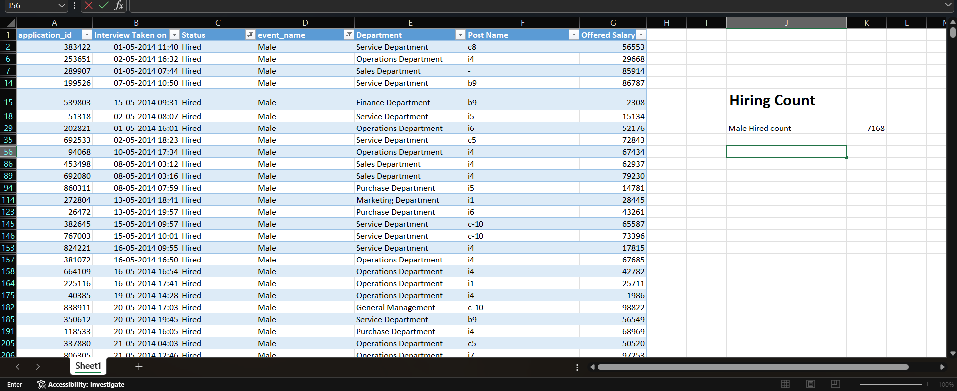

Slide 6
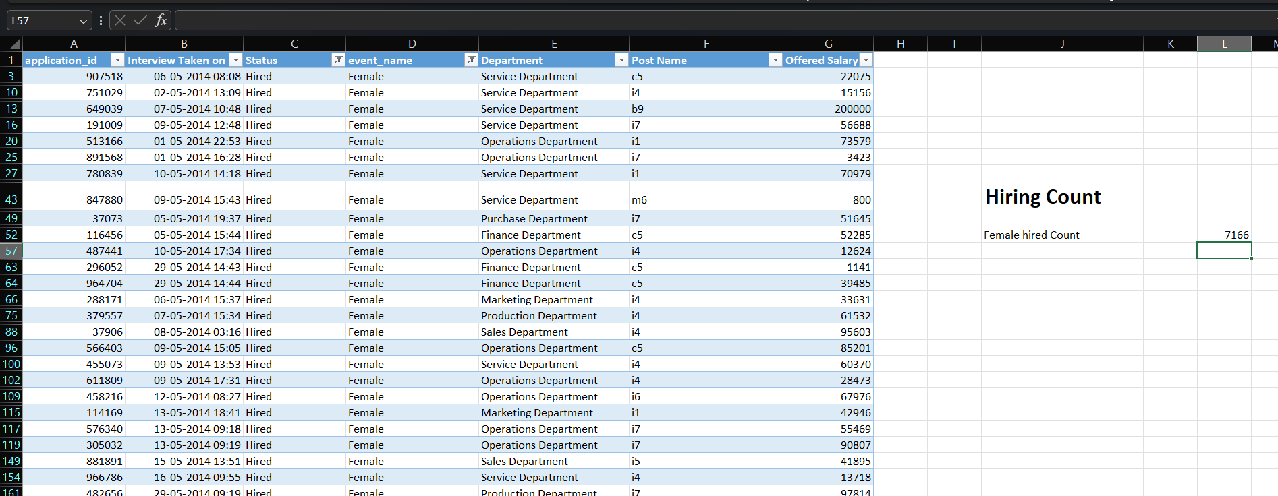

Slide 7
Data Analytics Tasks:
Salary Analysis: The average salary is calculated by adding up the salaries of a group of employees and then dividing
the total by the number of employees.
Your Task: What is the average salary offered by this company? Use Excel functions to calculate this.
Back to Agenda Page

Slide 8
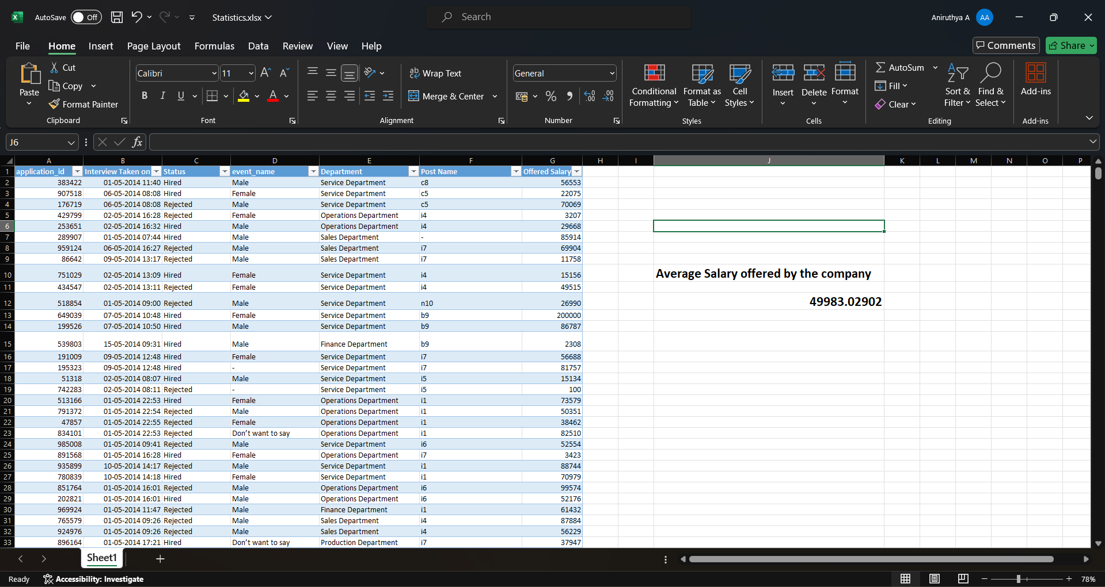

Slide 9
Data Analytics Tasks:
Salary Distribution: Class intervals represent ranges of values, in this case, salary ranges. The class interval is
the difference between the upper and lower limits of a class.
Your Task: Create class intervals for the salaries in the company. This will help you understand
the salary distribution.
Back to Agenda Page

Slide 10
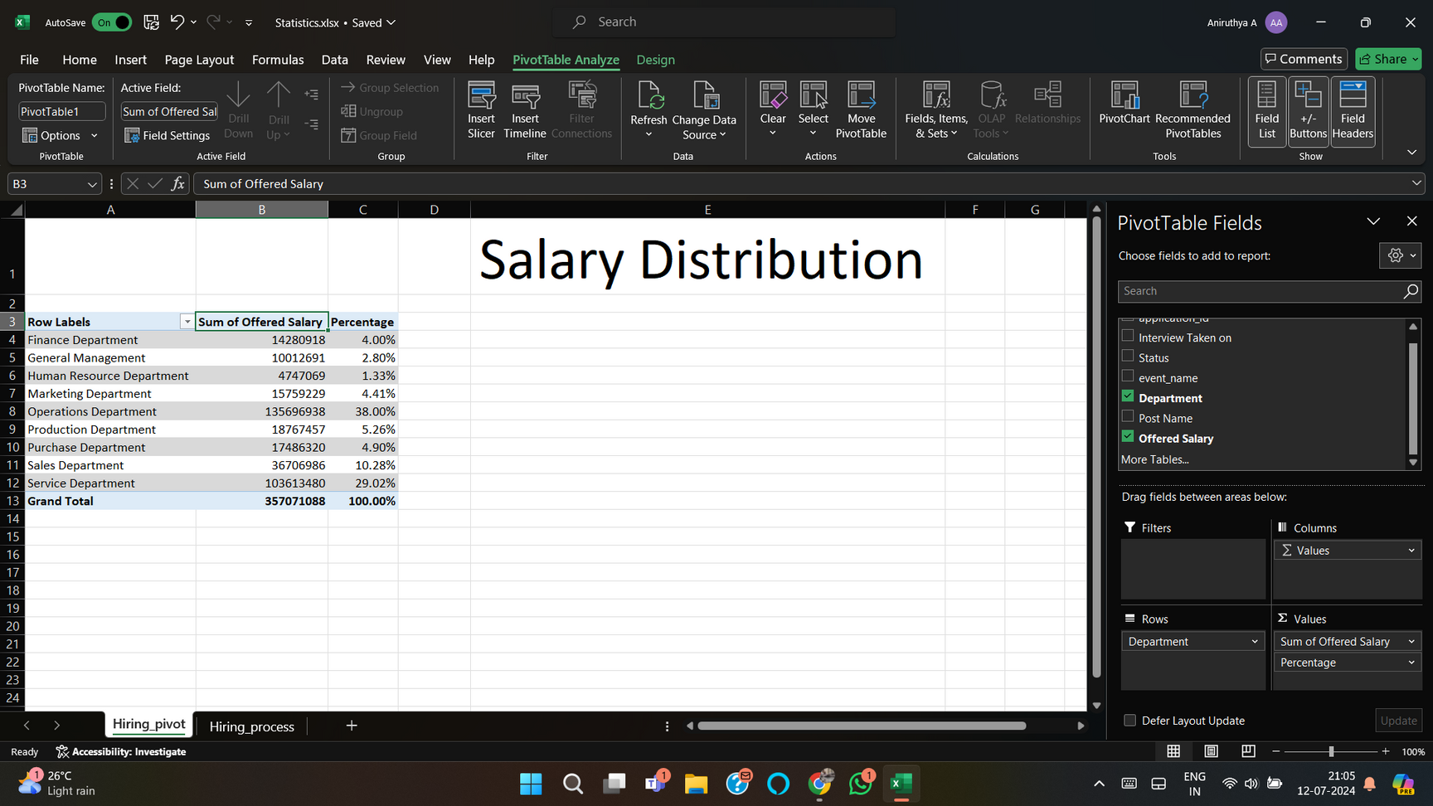

Slide 11
Data Analytics Tasks:
Departmental Analysis: Visualizing data through charts and plots is a crucial part of data analysis.
Your Task: Use a pie chart, bar graph, or any other suitable visualization to show the proportion of people working in
different departments.
Back to Agenda Page

Slide 12
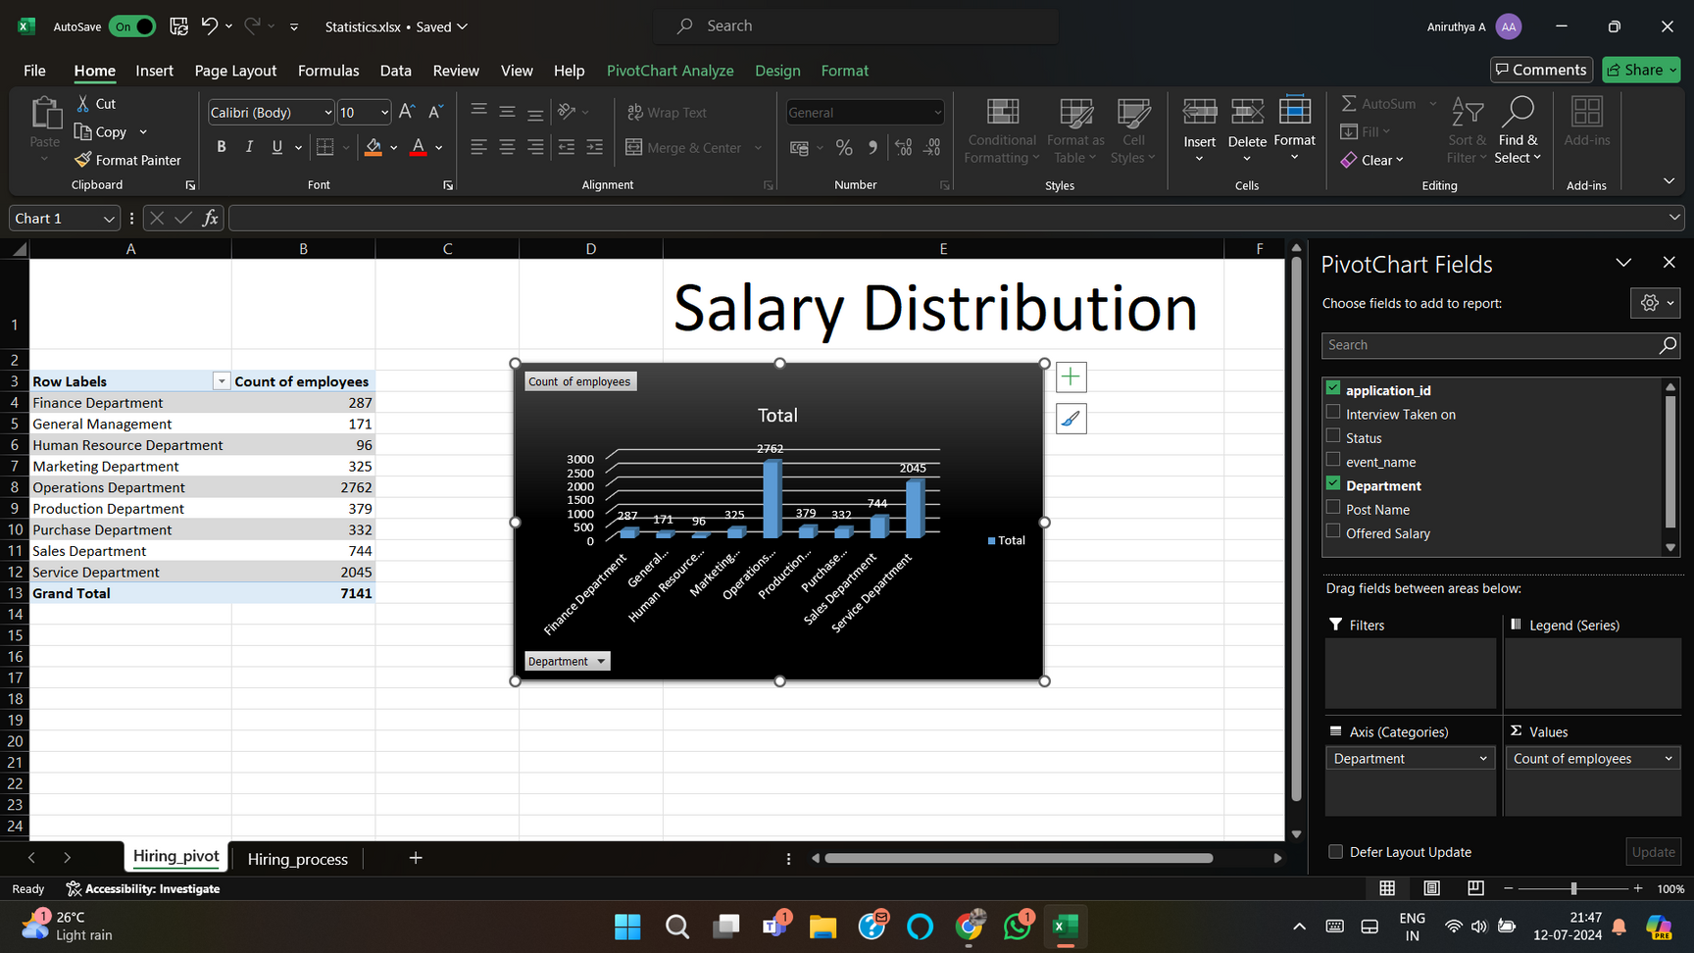

Slide 13
Data Analytics Tasks:
Position Tier Analysis: Different positions within a company often have different tiers or levels.
Your Task: Use a chart or graph to represent the different position tiers within the company. This will help you
understand the distribution of positions across different tiers.
Back to Agenda Page

Slide 14
